Slide 1
Weather Prediction Using Machine Learning
Group Member:
M Arslan Jameel (2022-CS-816)
Raheel Anjum (2022-CS-810)

Slide 2
Outline
Introduction
Objectives
Dataset Description
Data Preprocessing
Model Selection
API Integration
Application Interface

Slide 3
Continue Outline…
Results and Predictions
Conclusion
References

Slide 4
Introduction
The project explores how machine learning and AI can improve weather prediction.
Weather prediction impacts agriculture, transportation, and daily activities.
Integration of real-time weather data ensures accurate and timely forecasts.

Slide 5
Objectives
Predict temperature using humidity, wind speed, and precipitation.
Leverage machine learning for accurate forecasting.
Use the Weather Map API to fetch real-time data.
Design a Streamlit-based interface for predictions.
Store and manage data in Microsoft SQL Server.

Slide 6
Dataset Description
Source: Dataset Source Kaggle.
Features:
→Input: Humidity, Wind Speed, Precipitation.
→Target: Temperature.
Dataset Size: One Million rows and Six columns.
Sample: Display a table with a few rows.

Slide 7
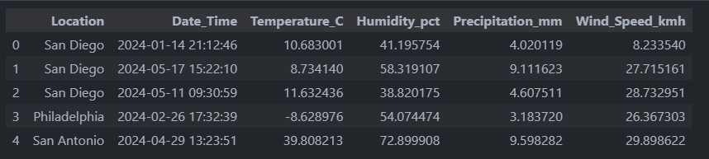
Continue Dataset Description…

Slide 8
Data Preprocessing
Steps Taken:
→Checked and handled missing values.
→Normalized features for consistent scaling.
Split data into training (80%) and testing (20%) sets.
Pandas, NumPy, Scikit-learn

Slide 9
Model Selection
Algorithm: Random Forest.
Why Random Forest?
→Handles non-linear relationships effectively.
→Robust against overfitting.

Slide 10
API Integration
API Used: OpenWeatherMap API.
Data Fetched: Humidity, Wind Speed, Precipitation.
Purpose: To provide real-time weather data for Prediction Implementation:
→Fetched JSON data using API keys.
→Parsed and integrated data into the prediction pipeline.

Slide 11
Application Interface
Tool: Streamlit.
Features:
→Input location and fetch real-time weather data.
→Display predictions with "View Prediction" button.
→Simple, clean, and interactive UI.

Slide 12
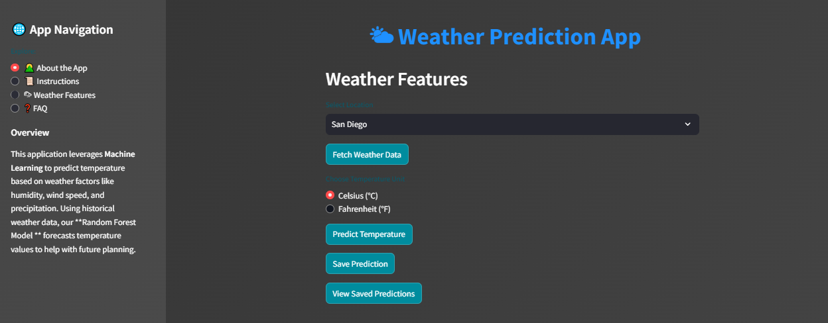
Application Interface…

Slide 13
Results and Predictions
Evaluation Metrics:
→Mean Absolute Error (MAE): 12.73
→R² Score: -0.05
Sample Predictions:
→Display a table with predicted and actual temperatures.

Slide 14
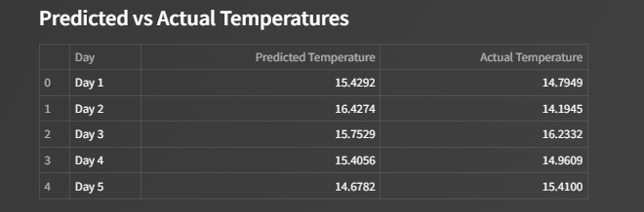
Results and Predictions Continue…

Slide 15
Conclusion
Successfully predicted temperature using ML and real-time data.
Created a user-friendly interface with Streamlit.
Integrated Microsoft SQL Server for data management.
Highlighted the potential of AI in weather forecasting.

Slide 16
References
Dataset Source: -[https://www.kaggle.com/code/mikedelong/put-mean-data-on-maps?select=weather_data.csv].
OpenWeatherMap API:
[https://openweathermap.org/api/weather-map-2].
Tools: Python, Streamlit, Scikit-learn, Microsoft SQL Server.

Slide 17


